Slide 1



Discrete Mathematics 2025 Spring
魏可佶 kejiwei@tongji.edu.cn

Slide 2
Chapter 5：Function
5.1 Function Definition and Properties
5.2 Composition of Functions and Inverse Functions
5.3 Relational Algebra
Notes:
5.1 函数定义及其性质
5.2 函数的复合与反函数
5.3 关系代数

Slide 3
5.1 Function Definition and Properties
5.1.1 Definition of a Function
Equality of functions
Function's domain, range, and direction
Surjective, Injective, and Bijective Functions
Function Sets and Counting
Constant, Identity, and Monotonic Functions
Natural mapping
Equivalence relation’s impact on natural mapping
The order of a complexity function
5.1.2 Image and Preimage of a Function
5.1.3 Properties of a Function
Notes:
5.1.1 函数的定义
5.1.2 函数的像与完全原像
5.1.3 函数的性质

Slide 4
5.1 Function Definition and Properties
⤷5.1.1 Definition of a Function
Definition 5.1: function Let f be a binary relation. If for every ∀x∈domf there exists a unique y∈ranf such that x f y holds, then f is called a function. For a function f, if x f y, we denote this as y=f(x), and y s called the value of f at x.
For example: f₁={<x₁,y₁>,<x₂,y₂>,<x₃,y₂>} f₂={<x₁,y₁>,<x₁,y₂>}
f₁ is a function, but f₂ is not a function.
Notes:
一个x只有一个y
定义5.1 设 f 为二元关系, 若 ∀x∈domf 都存在唯一的y∈ranf 使 x f y 成立, 则称 f为函数. 对于函数f, 如果有 x f y, 则记作 y=f(x), 并称 y 为 f 在 x 的值.
例如 f₁={<x₁,y₁>,<x₂,y₂>,<x₃,y₂>} f₂={<x₁,y₁>,<x₁,y₂>}
f₁是函数, f₂不是函数

Slide 5
5.1.1 Definition of a Function
⤷Equality of functions
Definition 5.2: Equality of functions Let f, g be functions. Then, f, g are equal if and only if their set representations are equal: f=g ⇔ f⊆g∧g⊆f
If two functions f and g are equal, the following two conditions must be satisfied:
(1) domf = domg
(2) ∀x∈domf = domg
we have f(x) = g(x)
Example: f(x)=(x²−1)/(x+1), g(x)=x−1
These functions are not equal because domf⊂domg.
Notes:
定义5.2 设f, g为函数, 则 f, g相等就是它们的集合表达式相等 f=g ⇔ f⊆g∧g⊆f
如果两个函数 f 和 g 相等, 一定满足下面两个条件： (1) domf = domg (2) ∀x∈domf = domg 都有 f(x) = g(x)
实例 函数
f(x)=(x²−1)/(x+1), g(x)=x−1
不相等, 因为 domf⊂domg.

Slide 6
5.1.1 Definition of a Function
⤷Function's domain, range, and direction
Definition 5.3: function f:A→B Let A and B be sets. If
(1) f is a function,
(2) domf = A and
(3) ranf ⊆ B,
then f is called a function from A to B, denoted by f : A→B.
Examples:
f : N→N, f(x)=2x is a function from N to N
g : N→N, g(x)=2 is also a function from N to N
Notes:
定义5.3 设A, B为集合, 如果
(1) f 为函数
(2) domf = A
(3) ranf ⊆ B,
则称 f 为从A到B的函数, 记作 f : A→B.
实例
f : N→N, f(x)=2x 是从 N 到 N 的函数
g : N→N, g(x)=2也是从 N 到 N 的函数

Slide 7
5.1.1 Definition of a Function
⤷ Surjective, Injective, and Bijective Functions
映射
映射
映射
Definition 5.4: Let f : A→B
A function f:A→B is subjective (onto) if and only if for every b∈B, there exists an a∈A such that f(a)=b .
function f:A→B is injective if and only if for all a,b∈A, we have f(a)= f(b) ⇒a=b.
If f:A→B is both surjective and injective, then it is called a bijective function (or bijection).
Examples:
每个映射都是满射当它的陪域限制为它的值域时，每个单射导出一个到它的值域的双射。
Notes:
则称 f 为从A到B的函数, 记作 f : A→B.
每个映射都是满射当它的陪域限制为它的值域时，每个单射导出一个到它的值域的双射。

Slide 8
5.1.1 Definition of a Function
⤷ Function Sets and Counting
Definition 5.5: The set of all functions from A to B is denoted by B^{A}, read as“B to the power of A”
In symbolic form: B^{A} ={ f | f : A→B }
Counting B^{A} :
|A|=m, |B|=n, and m, n>0, |B^{A}|=n^{m}.
A=∅, then B^{A}=B∅={∅}.
The function set contains only one element: the empty function. ∣B∅ ∣=1
A≠∅ and B=∅, then B^{A}=∅^{A}= ∅.
here is no function from a non-empty set to the empty set.∣∅^{A}∣=0
Notes:
定义5.4 所有从A到B的函数的集合记作B^{A}, 读作“B上A”
符号化表示为 B^{A} ={ f | f : A→B }
计数：
|A|=m, |B|=n, 且m, n>0, |B^{A}|=n^{m}.
A=∅, 则 B^{A}=B∅={∅}. A≠∅且B=∅, 则 B^{A}=∅^{A}= ∅.

Slide 9
5.1.1 Definition of a Function
⤷ Determining Function Sets
Example: Let A = {1, 2, 3}, B = {a, b}, solve B^{A}.
Solve: Find all possible functions from A to B.
B^{A} = { f₀, f₁, … , f₇ }, then f₀={<1,a>,<2,a>,<3,a>} f₁={<1,a>,<2,a>,<3,b>}
f₂={<1,a>,<2,b>,<3,a>} f₃={<1,a>,<2,b>,<3,b>} f₄={<1,b>,<2,a>,<3,a>} f₅={<1,b>,<2,a>,<3,b>} f₆={<1,b>,<2,b>,<3,a>} f₇={<1,b>,<2,b>,<3,b>}
Notes:
例1 设A = {1, 2, 3}, B = {a, b}, 求B^{A}.

Slide 10
5.1.1 Definition of a Function
⤷ Constant, Identity, and Monotonic Functions
Definition 5.6:
(1) Let f：A→B, If there exists a constant c∈B such that for all x∈A, f(x)=c, then f : A→B is called a constant function.
(2) The identity relation I_{A} on A is called the identity function on A, where for all x∈A, I_{A}(x)=x.
(3) Let <A, ≼>, <B, ≼> be partially ordered sets，f : A→B called monotonically increasing (or simply monotonic) if for any x₁, x₂∈A, x₁≺x₂, ⇒ f(x₁) ≼ f(x₂);
strictly monotonically increasing if for any x₁, x₂∈A, x₁≺x₂, , ⇒ f(x₁) ≺ f(x₂).
Similarly, monotonically decreasing and strictly monotonically decreasing functions can be defined in the same manner.
Notes:
定义5.5
(1) 设f：A→B, 如果存在 c∈B 使得对所有的 x∈A 都有
f(x)=c, 则称 f : A→B是常函数.
(2) 称 A 上的恒等关系 I_{A}为 A 上的恒等函数, 对所有的
x∈A 都有 I_{A}(x)=x.
(3) 设<A, ≼>, <B, ≼>为偏序集，f : A→B，如果对任意的x₁, x₂∈A, x₁≺x₂, 就有 f(x₁) ≼ f(x₂), 则称 f 为单调递增的；
如果对任意的 x₁, x₂∈A, x₁≺x₂, 就有 f(x₁) ≺ f(x₂), 则称 f 为严格单调递增的.
类似的也可以定义单调递减和严格单调递减的函数.

Slide 11
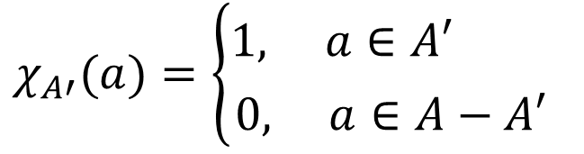

5.1.1 Definition of a Function
⤷ Characteristic function of a set
(4) Let A be a set. For any subset$A′$⊆A, the characteristic function
χ_{A’} : A→{0,1} is defined as follows:
Example：let A={a,b,c}, Each subset A’ of A corresponds to a characteristic function, and different subsets correspond to different characteristic functions. Such as :
χ∅ = {<a,0>,<b,0>,<c,0>}
χ_{{a,b}} = {<a,1>,<b,1>,<c,0>}
The characteristic function of a set is a detector that determines whether an element belongs to the set; it is also known as an indicator function that represents whether an event occurs.
$$χ_{A′}(a)=\left\{\begin{matrix}1, a∈A′ \\ 0, a∈A−A′\end{matrix}\right.$$
Notes:
(4) 设 A 为集合, 对于任意的 A’ ⊆A, A’ 的特征函数
χ_{A’} : A→{0,1} 定义为
实例：设A={a,b,c}, A的每一个子集 A'都对应于一个特征函数, 不同的子集对应于不同的特征函数. 如
χ∅ = {<a,0>,<b,0>,<c,0>}，
χ_{{a,b}} = {<a,1>,<b,1>,<c,0>}.

Slide 12
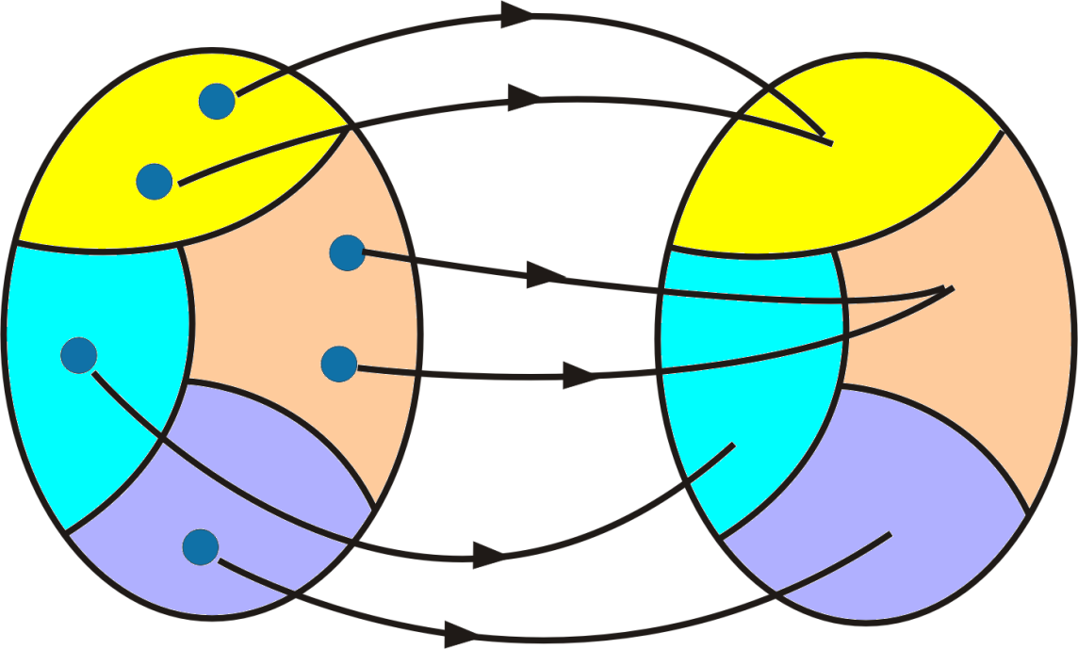
5.1.1 Definition of a Function
⤷ Natural mapping
(5) Let R be an equivalence relation on A . Define
g : A→A/R
g(a) = [a], ∀a∈A
Then g is called the natural mapping (function) from A to the quotient set A/R.
Notes:
自然映射是一个函数，它将集合A中的元素映射到商集A/R中的子集，而等价类是商集A/R中的子集，它们是由等价关系R定义的。自然映射提供了一种从原始集合到商集的映射方式，而等价类是商集的一部分，它们用于划分商集中的元素。自然映射函数的数量通常等于商集合中等价类的数量。
(5) 设 R 是 A 上的等价关系, 令 g : A→A/R g(a) = [a], ∀a∈A 称 g 是从 A 到商集 A/R 的自然映射（函数

Slide 13
5.1.1 Definition of a Function
⤷ Equivalence relation’s impact on natural mapping
Given a set A and an equivalence relation R on A, a natural mapping g : A→A/R can be determined.
Natural mappings vary with the equivalence relation:
The identity relation yields a bijection.
Others equivalence relations are generally surjections only.
Example：Let A={1, 2, 3},
Equivalence relation : R₁={<1,2>,<2,1>}∪I_{A}
Natural mapping ：g₁(1) = g₁(2) = {1,2}, g₁(3) = {3}
Equivalence relation：I_{A}
Natural mapping：g₂(1)={1}, g₂(2)={2}, g₂(3)={3}
Notes:
给定集合 A 和 A 上的等价关系 R, 就可以确定一个自然映射 g : A→A/R. 不同的等价关系确定不同的自然映射, 其中恒等关系所确定的自然映射是双射, 而其他的自然映射一般来说只是满射.
例如： A={1, 2, 3},
等价关系: R₁={<1,2>,<2,1>}∪I_{A}
自然映射：g₁(1) = g₁(2) = {1,2}, g₁(3) = {3}
等价关系：I_{A}
自然映射：g₂(1)={1}, g₂(2)={2}, g₂(3)={3}

Slide 14
5.1.1 Definition of a Function
⤷ The order of a complexity function
W : Z⁺→Z⁺ be the time complexity function of an algorithm. It is a discrete, monotonically increasing function defined on positive integers.
The meaning of W(n): For an input of size n, the number of basic operations executed by the algorithm in the worst case is W(n).
Asymptotic notation for the order of a complexity function f(n) ：
f(n)=O(g(n)) ⇔ f(n) is no more than that of g(n)
f(n)=Θ(g(n)) ⇔ f(n)=O(g(n)) and g(n)=O(f(n))
Examples: f(n)=n²+n=Θ(n²), g(n)=nlogn=O(n²) (Here, logn is shorthand for log₂n)
Algorithms：Binary search: W(n)=O(logn)
Merge sort: W(n)=O(nlogn)
Notes:
注意和数据结构的联系W : Z⁺→Z⁺作为算法的时间复杂度函数
W(n)的含义：对于规模为 n 的输入，该算法在最坏情况
下所执行的基本运算次数是W(n).
复杂度函数 f(n) 的阶的表示：
f(n)=O(g(n)) ⇔ f(n)的阶不超过g(n)的阶
f(n)=Θ(g(n)) ⇔ f(n)=O(g(n))且g(n)=O(f(n))
例如: f(n)=n²+n=Θ(n²), g(n)=nlogn=O(n²)
其中 logn 是 log₂n 的简写
算法：二分搜索 W(n)=O(logn)
归并排序 W(n)=O(nlogn)

Slide 15
5.1 Function Definition and Properties
5.1.1 Definition of a Function
5.1.2 Image and Preimage of a Function
5.1.3 Properties of a Function
Notes:
5.1.1 函数的定义
5.1.2 函数的像与完全原像
5.1.3 函数的性质

Slide 16
5.1.2 Image and Preimage of a Function
⤷ Image and complete preimage of the function
Definition 5.7：Let f:A→B be a function, and let A₁⊆A, B₁⊆B. Then:
f(A₁​)={f(x)∣x∈ A₁​} is called the image of A₁ ​under f. In particular, f(A) is called the image of the function.
f⁻¹(B₁)={x∣x∈A∧ f(x) ∈ B₁} is called the complete preimage of B₁ ​ under f.
Note :
A function value f(x)∈B is a point-to-point result, while an image f(A₁)⊆B is a set-to-set transformation.
A₁ ⊆ f⁻¹(f(A₁)) :The preimage of the image of A₁ ​ may contain more elements than A₁ ​ itself.
f(f⁻¹(B₁))⊆ B₁ :Taking the image of the preimage of B₁ may not recover the original set B_{1.}
A complete preimage is the source of a set of outputs; a preimage refers to the source of a single output. Both follow the same set operation rules.
Notes:
"A1 在 f 下的像" 和 "f 函数的像" 都是关于集合 B 中的元素，它们描述了通过函数 f 映射到 B 中的元素的性质。
"B1 在 f 下的完全原像" 是关于集合 A 中的元素，它描述了所有映射到 B1 中的元素的原像 a，其中 f(a) 属于集合 B1。
定义5.6 设函数 f : A→B, A₁⊆A, B₁⊆B,称 f(A₁) = { f(x) | x∈A₁ }
为A₁ 在 f 下的像，f(A) 称为函数的像.
f⁻¹(B₁)={ x | x∈A∧ f(x)∈B₁}
为B₁ 在 f 下的完全原像
注意:
函数的像与值的区别：函数值 f(x)∈B, 像 f(A₁)⊆B.
A₁⊆f⁻¹(f(A₁))， f(f⁻¹(B₁))⊆B₁.
实例 {1}⊂{1,2}=f⁻¹({a})= f⁻¹(f({1}))
f(f⁻¹({b,c}))=f({3})={b}⊂{b, c}

Slide 17
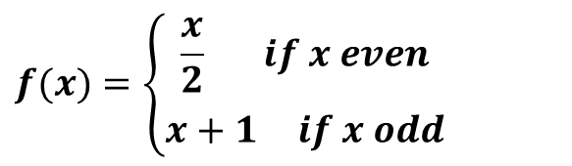
5.1.2 Image and Preimage of a Function
⤷ Image and complete preimage of the function (e.g.)
Examples:
(1) Let f : N→N, and let
A={0,1}, B={2}, then f(A) = f({0,1}) = { f(0), f(1) }={ 0, 2 }
f(B) = { f(2) } = { 1 }
(2) A={1, 2, 3}, B={a, b, c}, f={<1,a>,<2,a>,<3,b>}，then
f⁻¹({a,b}) ={1,2,3}, f⁻¹({b,c}) ={3}
{1}⊂{1,2}=f⁻¹({a})= f⁻¹(f({1})) （Non-injective functions expand preimages）
f(f⁻¹({b,c}))=f({3})={b}⊂{b, c} （Non-surjective ones shrink images ）
$$f(x)=\left\{\begin{matrix}\frac{x}{2} if x even \\ x+1 if x odd\end{matrix}\right.$$
Notes:
1. 设 f : N→N, 且
令A={0,1}, B={2}, 那么有 f(A) = f({0,1}) = { f(0), f(1) }={ 0, 2 }
f(B) = { f(2) } = { 1 }
2. A={1, 2, 3}, B={a, b, c}, f={<1,a>,<2,a>,<3,b>}，则
f⁻¹({a,b}) ={1,2,3}, f⁻¹({b,c}) ={3},

Slide 18
5.1 Function Definition and Properties
5.1.1 Definition of a Function
5.1.2 Image and Preimage of a Function
5.1.3 Properties of a Function
Surjective, Injective, and Bijective Functions
Constructing a bijective function
Notes:
5.1.1 函数的定义
5.1.2 函数的像与完全原像
5.1.3 函数的性质

Slide 19
5.1.3 Properties of a Function
⤷ Surjective, Injective, and Bijective Functions(e.g.)
Definitions of Surjective, Injective, and Bijective Functions
Note：
Surjectivity means: for ∀y ∈B, here exists an x∈A such that f(x)=y.
Injectivity means: if ：f(x₁)=f(x₂) ⇒ x₁=x_{2 .}
A surjection ensures full coverage of the codomain, an injection ensures no duplication in mapping, and a bijection guarantees reversibility.
Examples: Determine whether the following functions are injective, surjective, or bijective, and explain why. （1） f：R→R, f(x)=−x²+2x−1
Solution: When x=0,2 ，f(x)=-1， so it is not injective .
Notes:
则称 f 为从A到B的函数, 记作 f : A→B.
每个映射都是满射当它的陪域限制为它的值域时，每个单射导出一个到它的值域的双射。

Slide 20
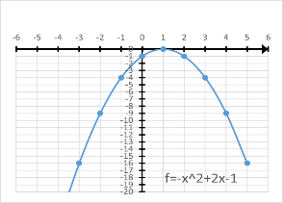
5.1.3 Properties of a Function
⤷ Surjective, Injective, and Bijective Functions(e.g.)
Examples: Determine whether the following functions are injective, surjective, or bijective, and explain why. （1） f：R→R, f(x)=−x²+2x−1
Solution: When x=0,2 ，f(x)=-1， so it is not injective .
As shown in the figure, the function f cannot map to any positive real number, and thus it is neither surjective nor bijective.
Notes:
则称 f 为从A到B的函数, 记作 f : A→B.
解：x分别取0,2时，f(x)=-1，不单射；
函数是一个开口向下的抛物线，x=1取得极大值0， 不能映射到大于0的任何实数 ，不满射、不双射。
每个映射都是满射当它的陪域限制为它的值域时，每个单射导出一个到它的值域的双射。

Slide 21
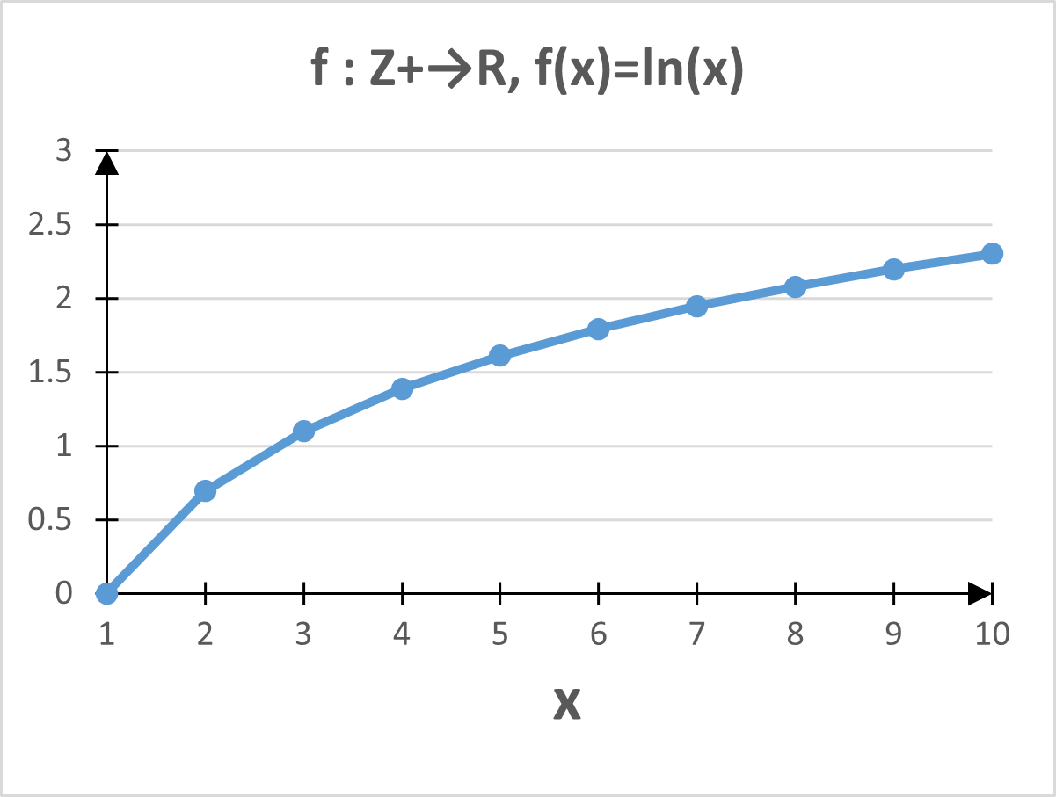
5.1.3 Properties of a Function
⤷ Surjective, Injective, and Bijective Functions(e.g.)
Examples: Determine whether the following functions are injective, surjective, or bijective, and explain why. （2） f： Z⁺→R, f(x)=lnx, Z⁺ is the set of positive integers.
Solution:
Solution: f(x) is monotonically increasing, so it is injective.
Since ranf={ln⁡1,ln⁡2,…} cannot cover all values in the real number set R, f is not surjective.
Notes:
则称 f 为从A到B的函数, 记作 f : A→B.
（2）f : Z⁺→R, f(x)=lnx, Z⁺为正整数集
解： f(x)是单调上升, 是单射. 但不满射, ranf={ln1, ln2, …}，无法覆盖实数集R上的所有值。
每个映射都是满射当它的陪域限制为它的值域时，每个单射导出一个到它的值域的双射。

Slide 22
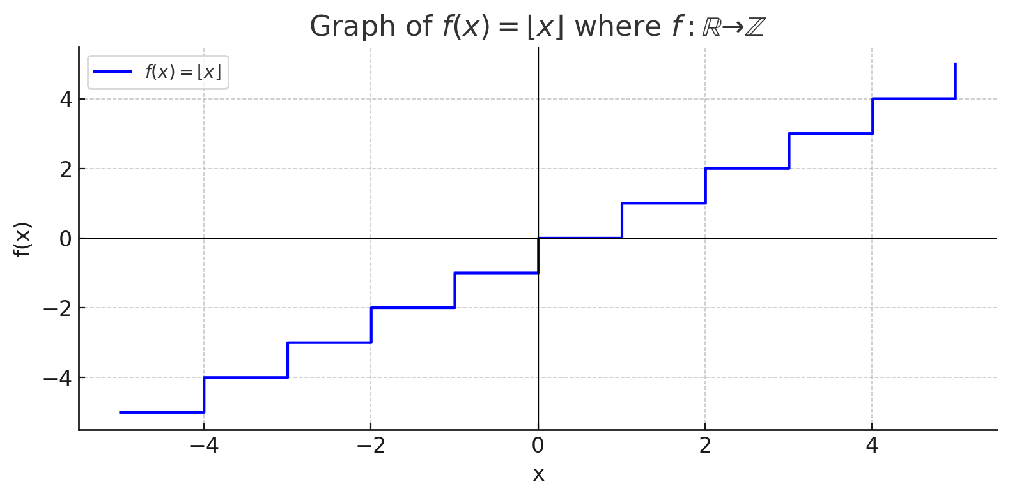
5.1.3 Properties of a Function
⤷ Surjective, Injective, and Bijective Functions(e.g.)
Examples: Determine whether the following functions are injective, surjective, or bijective, and explain why. （3） f : R→Z, f(x)=⎣x⎦
Solution:
Every integer f(x) has a corresponding real number x, so the function is surjective. However, different real numbers may have the same floor value f(x), so the function is not injective.
Notes:
则称 f 为从A到B的函数, 记作 f : A→B.
每个映射都是满射当它的陪域限制为它的值域时，每个单射导出一个到它的值域的双射。
满射, 但不单射, 例如 f(1.5)=f(1.2)=1.

Slide 23
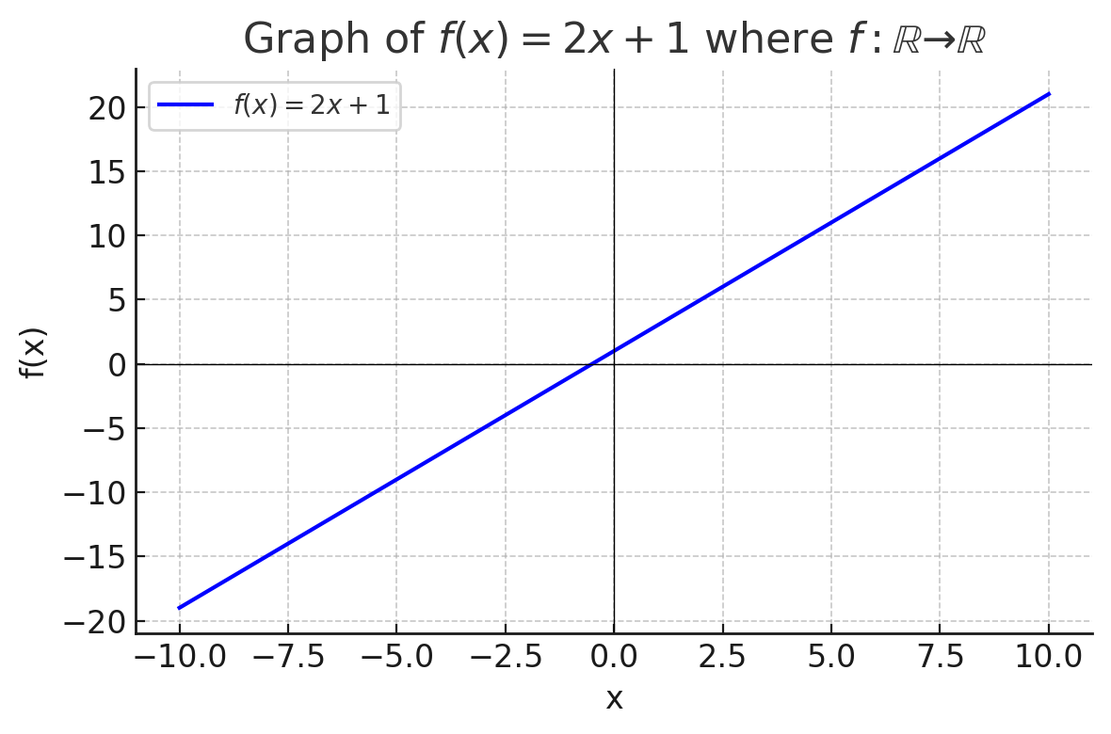
5.1.3 Properties of a Function
⤷ Surjective, Injective, and Bijective Functions(e.g.)
Examples: Determine whether the following functions are injective, surjective, or bijective, and explain why. （4） f : R→R, f(x)=2x+1 Solution:
Surjective, injective, bijective, because it is monotonic and the range of ranf=R
Notes:
则称 f 为从A到B的函数, 记作 f : A→B.
每个映射都是满射当它的陪域限制为它的值域时，每个单射导出一个到它的值域的双射。

Slide 24
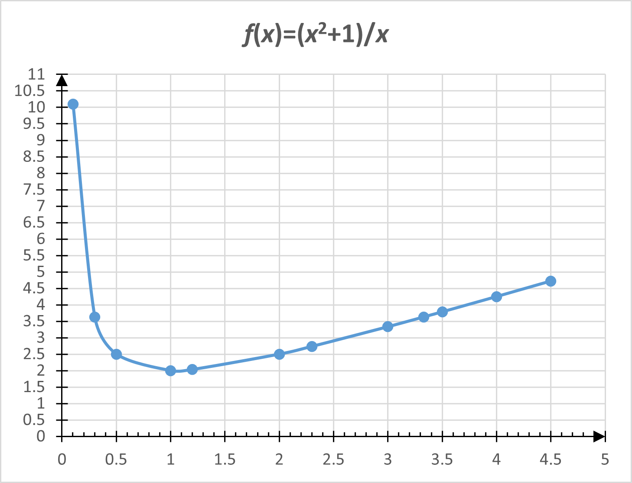
5.1.3 Properties of a Function
⤷ Surjective, Injective, and Bijective Functions(e.g.)
Examples: Determine whether the following functions are injective, surjective, or bijective, and explain why. （5） f : R⁺→R⁺, f(x)=(x²+1)/x , where R⁺ is the set of positive real numbers.
Solution:
The function has a minimum value f(1)=2. This function is neither injective nor surjective.
Notes:
则称 f 为从A到B的函数, 记作 f : A→B.
（5）f : R⁺→R⁺, f(x)=(x²+1)/x, 其中R⁺为正实数集.
有极小值f(1)=2. 该函数既不单射也不满射
每个映射都是满射当它的陪域限制为它的值域时，每个单射导出一个到它的值域的双射。

Slide 25
5.1.3 Properties of a Function
⤷ Constructing a bijective function (between finite sets)(e.g.)
Example: A=P({1,2,3}), B={0,1}^{{1,2,3}}
Solve: A={∅,{1},{2},{3},{1,2},{1,3},{2,3},{1,2,3}}.
B={f₀, f₁, … , f₇}.
f₀={<1,0>,<2,0>,<3,0>}, f₁={<1,0>,<2,0>,<3,1>}, f₂={<1,0>,<2,1>,<3,0>}, f₃={<1,0>,<2,1>,<3,1>}, f₄={<1,1>,<2,0>,<3,0>}, f₅={<1,1>,<2,0>,<3,1>}, f₆={<1,1>,<2,1>,<3,0>}, f₇={<1,1>,<2,1>,<3,1>}.
Let f : A→B,
f(∅)=f₀, f({1})=f₁, f({2})=f₂, f({3})=f₃,
f({1,2})=f₄, f({1,3})=f₅, f({2,3})=f₆, f({1,2,3})=f₇
Each subset in A is mapped to its characteristic function. For example, f({2})=f₂ ​, since only element 2 is in the subset, its characteristic value is (0,1,0).
Notes:
集合 B：由 8 个特征函数组成，每个函数 fi∈B 是 {1,2,3}→{0,1} 的映射，也可以理解为一个三位的二进制数，表示某个子集的“特征”。

Slide 26
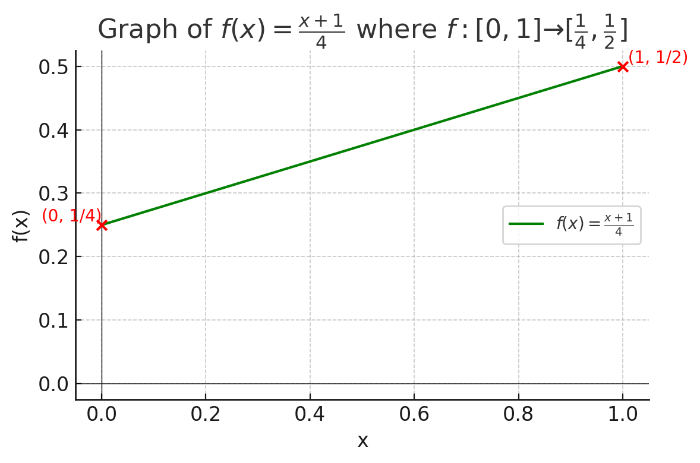
5.1.3 Properties of a Function
⤷ Constructing a bijective function (between real intervals)(e.g.)
Construction Method: Linear Equation
Example: A=[0,1] , B=[1/4,1/2] Construct a bijection f : A→B
Solve: To map A=[0,1] onto B=[1/4,1/2], match the endpoints and use a straight-line function to create a bijection.
Let f : [0,1]→[1/4,1/2]
f(x)=(x+1)/4
Notes:
集合 B：由 8 个特征函数组成，每个函数 fi∈B 是 {1,2,3}→{0,1} 的映射，也可以理解为一个三位的二进制数，表示某个子集的“特征”。

Slide 27
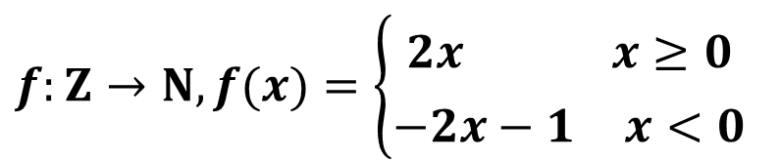
5.1.3 Properties of a Function • Constructing a bijective function
⤷ (between set A and the set of natural numbers)(e.g.)
Construction Method: Arrange the elements of set A in a specific order based on a certain criterion. Then, starting from the first element, map them sequentially to the natural numbers.
Example: A=Z, B=N，Construct a bijection f : A→B
Solve : Arrange the elements of Z in the following order and correspond them with the elements of N:
Z：0 −1 1 −2 2 −3 3 … ↓ ↓ ↓ ↓ ↓ ↓ ↓ N：0 1 2 3 4 5 6 …
The function represented by this correspondence is:
$$f:Z→N,f(x)=\left\{\begin{matrix}2x x≥0 \\ −2x−1 x<0\end{matrix}\right.$$
Notes:
集合 B：由 8 个特征函数组成，每个函数 fi∈B 是 {1,2,3}→{0,1} 的映射，也可以理解为一个三位的二进制数，表示某个子集的“特征”。

Slide 28
5.1 Function Definition and Properties • Brief summary
Objective :
Key Concepts ：

Slide 29
Discrete Mathematics 2025 Spring
魏可佶 kejiwei@tongji.edu.cn

Slide 30
Chapter 5：Function
5.1 Function Definition and Properties
5.2 Composition of Functions and Inverse Functions
5.3 Relational Algebra
Notes:
5.1 函数定义及其性质
5.2 函数的复合与反函数
5.3 关系代数

Slide 31
5.2 Composition of Functions and Inverse Functions
5.2.1 Composition of Functions
The fundamental theorem of function composition and its corollaries
Properties of function composition
5.2.2 Inverse Functions
Conditions for the existence of an inverse function
Properties of inverse function
Notes:
5.2.1 函数的复合
函数复合的基本定理及其推论
函数复合的性质
5.2.2 反函数
反函数存在的条件
反函数的性质

Slide 32
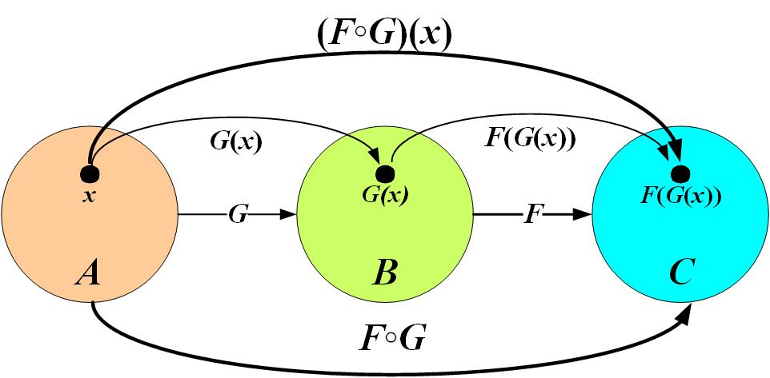
5.2 Composition of Functions and Inverse Functions
⤷ 5.2.1 Composition of Functions
Theorem 5.1：Let F,G be functions, then the composition F∘G is also a function and satisfies the following conditions: (1) dom(F∘G)={ x | x∈domG ∧ G(x)∈domF}
(This describes the relationship between the domains and ranges of the functions.)
(2) ∀x∈dom(F∘G) ，F∘G(x) = F(G(x))
(This specifies the order of computation for the composite function.)
Note: The composition of functions is left composition with right-hand priority, while the composition of relations is right composition with left-hand priority.
Notes:
定理5.1 设F,G是函数, 则F∘G也是函数, 且满足以下条件： (1) dom(F∘G)={ x | x∈domG ∧ G(x)∈domF}
（定义域和值域的对应关系） (2) ∀x∈dom(F∘G) 有 F∘G(x) = F(G(x))
（确定复合函数计算次序）
注：函数的复合是(向)左复合，右(边)优先；而关系的合成是(向)右复合，左(边)优先；
复合关系处理的是元素之间的关系，而复合函数处理的是函数输出之间的关系。
注： ●函数的复合其实就是关系的合成；只不过记法上有所不同；
●函数的复合是(向)左复合，右(边)优先；而关系的合成是(向)右复合，左(边)优先；

Slide 33
5.2.1 Composition of Functions
⤷ Function Composition and Mapping Properties
Theorem 5.2： Let f : B→C, g : A→B.
(1) If f , g are surjective, then f∘g : A→C is also surjective.
(2) If both f , g are injective, then the composition f∘g : A→C is also injective.
(3) If both f , g are bijective, then the composition f∘g : A→C is also bijective.
Notes:
定理5.2 设 f : B→C A→B, g : A→B.
(1) 如果 f 、 g 是满射的, 则 f∘g : A→C也是满射的.
(2) 如果 f 、 g 是单射的, 则 f∘g : A→C也是单射的.
(3) 如果 f 、 g 是双射的, 则 f∘g : A→C也是双射的.
证(1)：只要证明，对于C中的每个元素 c，存在至少一个 A 中的元素 a 使得 (f∘g)(a)=c。
对于 C中的任意元素 c， f 的满射性使得必有B中的元素b使得 f (b)=c。g的满射性使得必有A中的元素a使得 g (a)= b。有了g (a)= b和 f (b)=c ，根据复合函数的定义有 (f∘g)(a)=f(g(a))=f(b)=c。
从而证明了f∘g : A→C是满射的

Slide 34
5.2.1 Composition of Functions
⤷ Function Composition and Mapping Properties
Theorem 5.2： Let f : B→C, g : A→B.
(1) If f , g are surjective, then f∘g : A→C is also surjective.
proof : Goal: Prove that for any c∈C, there exists at least one element a∈A such that (f∘g)(a)=c.
①Since f is surjective, for any c∈C, there exists some b∈B such that f(b)=c.
②Since g is also surjective, there exists some a∈A such that g(a)=b.
③Given that g(a)=b and f(b)=c, by the definition of function composition, we have: (f∘g)(a)= f(g(a))=f(b)=c.
Therefore, f∘g : A→C is surjective.
Notes:
定理5.2 设 f : B→C A→B, g : A→B.
(1) 如果 f 、 g 是满射的, 则 f∘g : A→C也是满射的.
(2) 如果 f 、 g 是单射的, 则 f∘g : A→C也是单射的.
(3) 如果 f 、 g 是双射的, 则 f∘g : A→C也是双射的.
证(1)：只要证明，对于C中的每个元素 c，存在至少一个 A 中的元素 a 使得 (f∘g)(a)=c。
对于 C中的任意元素 c， f 的满射性使得必有B中的元素b使得 f (b)=c。g的满射性使得必有A中的元素a使得 g (a)= b。有了g (a)= b和 f (b)=c ，根据复合函数的定义有 (f∘g)(a)=f(g(a))=f(b)=c。
从而证明了f∘g : A→C是满射的

Slide 35
5.2.1 Composition of Functions
⤷ Function Composition and Mapping Properties
Theorem 5.2： Let f : B→C, g : A→B.
(2) If both f , g are injective, then the composition f∘g : A→C is also injective.
proof : Goal: We need to prove that if x₁, x₂∈A, x₁ ≠ x_{2,} then f∘g(x₁) ≠ f∘g(x₂).
①Since g injective, g(x₁) ≠ g(x₂)，and g(x₁) , g(x₂) ∈ B=domf。
②Since f injective, we know that f (g(x₁) ) ≠ f (g(x₂) ) ，thus f∘g(x₁) ≠ f∘g(x₂).
so f∘g : A→C is injective.
Notes:
定理5.2 设 f : B→C A→B, g : A→B.
(1) 如果 f 、 g 是满射的, 则 f∘g : A→C也是满射的.
(2) 如果 f 、 g 是单射的, 则 f∘g : A→C也是单射的.
(3) 如果 f 、 g 是双射的, 则 f∘g : A→C也是双射的.
证(1)：只要证明，对于C中的每个元素 c，存在至少一个 A 中的元素 a 使得 (f∘g)(a)=c。
对于 C中的任意元素 c， f 的满射性使得必有B中的元素b使得 f (b)=c。g的满射性使得必有A中的元素a使得 g (a)= b。有了g (a)= b和 f (b)=c ，根据复合函数的定义有 (f∘g)(a)=f(g(a))=f(b)=c。
从而证明了f∘g : A→C是满射的

Slide 36
5.2.1 Composition of Functions
⤷ Identity Property of Function Composition
Theorem 5.3: Let f : A→B，then f = f ∘I_{B}=I_{A}∘f
proof : For any x∈A:
①(f∘I_{B})(x)=f(I_{B}(x))=f(x) so f∘I_{B} =f
②(I_{A}∘f)(x)=I_{A}(f(x))=f(x) so I_{A}∘f =f
Thus, f = f ∘I_{B}=I_{A}∘f
Reflection ：
f ∘I_{B} = I_{B} ∘ f ？
I_{A}∘f = f ∘ I_{A}？
Please analyze based on the matching between the domain of the identity function and the codomain of the other function.
Notes:
恒等映射在函数复合中相当于乘法中的“1”，即它在复合中不改变其他函数的本质。证明见备注
定理5.3 设 f : A→B，则
f = f ∘I_{B}=I_{A}∘f
思考：
f ∘I_{B} = I_{B} ∘ f 吗？
I_{A}∘f = f ∘ I_{A}吗？
请从恒等函数的定义域和另一个函数的值域匹配情况进行分析

Slide 37
5.2 Composition of Functions and Inverse Functions
5.2.1 Composition of Functions
The fundamental theorem of function composition and its corollaries
Properties of function composition
5.2.2 Inverse Functions
Conditions for the existence of an inverse function
Properties of inverse function
Notes:
5.2.1 函数的复合
函数复合的基本定理及其推论
函数复合的性质
5.2.2 反函数
反函数存在的条件
反函数的性质

Slide 38
5.2.2 Inverse Functions
⤷ Inverse Function Existence Theorem
Theorem 5.4: Let f : A→B be bijective, so f⁻¹: B→A is also bijective.
Proof:
①Since f is a function, so f⁻1 is relation, and we have domf ⁻¹= ranf =B , ranf ⁻¹= domf =A.
②For any x∈B, suppose have y₁, y₂∈A such that <y₁,x>∈f⁻¹∧<y₂, x>∈f⁻¹ , then by the definition of inverse <x,y₁>∈f∧<x,y₂>∈f. Since f is injective, it follows that y₁=y₂, hence f⁻¹ is a well-defined function.
③Also, for every x∈B, there is a unique a∈A such that f(a)=x, so f⁻¹(x)=a, therefore, f⁻¹ is surjective.
④Now, suppose exist x₁, x₂∈B such that f⁻¹(x₁) = f⁻¹(x₂)=y, then we have
<y, x₁>∈f⁻¹∧<y, x₂>∈f ⁻¹ ⇒ <x_{1,}y >∈f ∧<x₂,y>∈f ⇒ x₁=x₂
(Since f is injective function),then proves that f⁻¹ is injective .
Conclusion: Since f⁻¹ is both injective and surjective, f⁻¹ :B→A is a bijective function.
Notes:
任给函数 F, 它的逆F ⁻¹不一定是函数, 是二元关系.
实例：F={<a,b>,<c,b>}， F ⁻¹={<b,a>,<b,c>}
任给单射函数 f：A→B, 则 f ⁻¹是函数, 且是从 ranf 到 A的双射函数, 但不一定是从 B 到 A 的双射函数.
实例：f : N →N, f(x) = 2x,
f ⁻¹ : ranf →N, f ⁻¹ (x) = x/2
定理5.4 设 f : A→B是双射的, 则f⁻¹: B→A也是双射的.
证 因为 f 是函数, 所以 f ⁻¹是关系, 且
dom f ⁻¹= ranf =B , ran f ⁻¹= domf =A,
对于任意的 x∈B, 假设有 y₁, y₂∈A 使得
<y₁ , x >∈f ⁻¹∧<y₂, x >∈f ⁻¹ 成立, 则由逆的定义有
<x , y₁>∈f ∧<x , y₂>∈f. 根据 f 的单射性可得 y₁=y₂, 从而证
明了f ⁻¹是函数，且是满射的.
若存在 x₁, x₂∈B使得 f ⁻¹(x₁) = f ⁻¹(x₂)=y, 从而有
<y , x₁>∈f ⁻¹∧<y , x₂ >∈f ⁻¹ ⇒ <x_{1,} y >∈f ∧<x₂ , y>∈f ⇒ x₁=x₂ 因为 f 是函数）
从而证明了f ⁻¹的单射性.
对于双射函数f : A→B, 称f ⁻¹: B→A是它的反函数

Slide 39

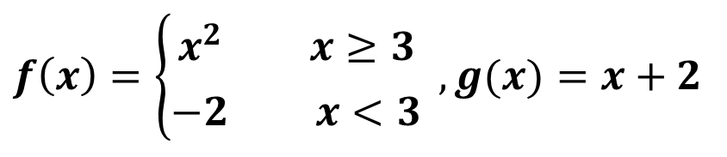
5.2.2 Inverse Functions
⤷ Find the inverse of a composite function
$$f\left(x\right)=\left\{\begin{matrix}x^{2} x≥3 \\ −2 x<3\end{matrix}\right. , g(x)=x+2$$
Example: Let f : R→R, g : R→R,
Find f ∘g, g∘f.
If f and g have inverse functions, find their inverses.
Solve :
$$g∘f: R→R f∘g:R→R \\ g∘f(x)=\left\{\begin{matrix}x^{2}+2 x≥3 \\ 0 x<3\end{matrix}\right. f∘g(x)=\left\{\begin{matrix}(x+2)^{2} x≥1 \\ −2 x<1\end{matrix}\right.$$
f : R→R does not have an inverse function .
g : R→R inverse function is g⁻¹: R→R, g⁻¹(x)=x−2 .
Notes:
f : R→R不存在反函数；g : R→R的反函数是 g⁻¹: R→R, g⁻¹(x)=x−2

Slide 40
5.2.2 Inverse Functions
⤷ Identity Composition Theorem of Inverse Functions
The composition of a bijective function and its inverse is the identity function.
Theorem 5.5: Let f : A→B be a bijective function, then: f ⁻¹∘f = I_{A}, f∘f ⁻¹ = I_{B}
Proof:
① According to Theorem 5.4 f ⁻¹: B→A is also bijective.
② By the theorem on function composition,f ⁻¹∘f : A→A , f∘f ⁻¹: B→B ，and both equal the corresponding identity functions.
③ By the above Therefore, we have: f ⁻¹∘f = I_{A} , f∘f ⁻¹ = I_{B}.
The left and right compositions of a bijective function and its inverse are identity functions on their respective sets, and I_{A} ​ is generally not equal to I_{B} ​.
Notes:
f⁻¹是 f 的逆函数，这意味着对于 B 中的每个元素 b，f⁻¹ (b) 将产生一个唯一的 A 中的元素 a，这样 f(a)=b。
同样，对于 A 中的每个元素 a， f(a) 将产生一个唯一的 B 中的元素 b，这样 f⁻¹ (b)=a。
因此：
f∘f⁻¹ 表示先应用 f⁻¹，然后应用 f。对于 B 中的每个元素 b，这个复合函数给出 f(f⁻¹ (b))=b，这正是 B 上的恒等函数 IB​。
f⁻¹∘f 表示先应用 f，然后应用 f⁻¹。对于 A 中的每个元素 a，这个复合函数给出 f⁻¹ (f(a))=a，这正是 A 上的恒等函数IA​。
这样我们可以得出结论，对于双射函数 f，复合函数 f∘f⁻¹=IB​ 并且 f⁻¹∘f=IA​。
双射函数与其反函数的复合函数都是恒等函数
定理5.5 设 f : A→B是双射的, 则 f ⁻¹∘f = I_{A}, f∘f ⁻¹ = I_{B}
证 根据定理5.4可知 f ⁻¹: B→A也是双射的.
由函数复合的定理可知 f ⁻¹∘f : B→B, f∘f ⁻¹: A→A，且它们都
是恒等函数.
对于双射函数 f : A→A, 根据上述定理有
f ⁻¹∘f = f∘f ⁻¹ = I_{A}.

Slide 41
5.2 函数的复合与反函数
⤷ 5.2.2 反函数•反函数的性质
The composition of a bijective function and its inverse is the identity function Theorem 5.5 Let f : A→B be a bijective function, then: f ⁻¹∘f = I_{A}, f∘f ⁻¹ = I_{B}
Proof According to Theorem 5.4 f ⁻¹: B→A is also bijective..
By the theorem on function composition,
f ⁻¹∘f : B→B, f∘f ⁻¹: A→A，and both are identity functions.
For a bijective function f : A→A, by the above theorem, we have:
f ⁻¹∘f = f∘f ⁻¹ = I_{A}.
Notes:
f⁻¹是 f 的逆函数，这意味着对于 B 中的每个元素 b，f⁻¹ (b) 将产生一个唯一的 A 中的元素 a，这样 f(a)=b。
同样，对于 A 中的每个元素 a， f(a) 将产生一个唯一的 B 中的元素 b，这样 f⁻¹ (b)=a。
因此：
f∘f⁻¹ 表示先应用 f⁻¹，然后应用 f。对于 B 中的每个元素 b，这个复合函数给出 f(f⁻¹ (b))=b，这正是 B 上的恒等函数 IB​。
f⁻¹∘f 表示先应用 f，然后应用 f⁻¹。对于 A 中的每个元素 a，这个复合函数给出 f⁻¹ (f(a))=a，这正是 A 上的恒等函数IA​。
这样我们可以得出结论，对于双射函数 f，复合函数 f∘f⁻¹=IB​ 并且 f⁻¹∘f=IA​。
双射函数与其反函数的复合函数都是恒等函数
定理5.5 设 f : A→B是双射的, 则 f ⁻¹∘f = I_{A}, f∘f ⁻¹ = I_{B}
证 根据定理5.4可知 f ⁻¹: B→A也是双射的.
由函数复合的定理可知 f ⁻¹∘f : B→B, f∘f ⁻¹: A→A，且它们都
是恒等函数.
对于双射函数 f : A→A, 根据上述定理有
f ⁻¹∘f = f∘f ⁻¹ = I_{A}.

Slide 42
Discrete Mathematics 2025 Spring
魏可佶 kejiwei@tongji.edu.cn

Slide 43
Chapter 5：Function
5.1 Function Definition and Properties
5.2 Composition of Functions and Inverse Functions
5.3 Relational Algebra
Notes:
5.1 函数定义及其性质
5.2 函数的复合与反函数
5.3 关系代数

Slide 44
5.3 Relational Algebra
5.3.1 Relational Algebra and Its Components
Algebra, Algebraic Systems, and Branches of Algebra
Relational Algebra and Relational Database Operations
Relational Model and Relational Database
5.3.2 Relational Algebra and Its Operations
5.3.3 Applications of Relational Algebra
Notes:
5.1 函数定义及其性质
5.2 函数的复合与反函数
5.3 关系代数

Slide 45
5.3.1 Relational Algebra and Its Components
⤷ Algebra, Algebraic Systems, and Branches of Algebra
Algebra is the science of studying operational structures.
Algebraic systems are the stage for these operations.
Algebraic branches are the specific forms performed on that stage.
Algebra Branch | Algebraic System | Description | Applications
Relational Algebra | (R,σ,π,∪,∩,×,…) | Operations on relations (tables) in databases | SQL, database query languages
Boolean Algebra | (B,∨,∧,¬) | Logic system over two values (true/false or sets) | Logic design, digital circuits
Linear Algebra | (V,+,⋅) | Vector spaces over a field with scalar multiplication | Physics, machine learning, data science
Group Theory(G,⋅), Ring Theory(R,+,⋅), Field Theory(F,+,⋅), Automata Algebra State-transition structures,….
Notes:
关系代数：是数据库理论中的概念，是一种特殊的代数系统，其元素是关系（表），运算则用于查询和处理存储在表中的数据，这些运算遵守特定的代数法则和性质。
代数系统（又称为代数结构）：是代数中更为具体的部分，定义了一组元素以及运算。简单的有集合和二元运算，复杂的有环、域、向量空间等。代数系统关注于这些结构的性质和它们之间的关系。
代数：数学的一个分支，研究数、符号和运算规则，如方程式、和多项式和更抽象的结构（群、环、域等）。

Slide 46
5.3.1 Algebra, Algebraic Systems, and Branches of Algebra
Relational Algebra: A concept in database theory, relational algebra is a special kind of algebraic system whose elements are relations (i.e., tables). The operations are used to query and manipulate data stored in the tables. These operations follow specific algebraic rules and properties.
Algebraic System (also known as Algebraic Structure): It is a more concrete part of algebra, defining a set of elements and operations. Simple examples include sets and binary operations, while more complex examples include rings, fields, and vector spaces. Algebraic systems focus on the properties of these structures and their relationships with one another.
Algebra: A branch of mathematics that studies numbers, symbols, and the rules of operations, such as equations, polynomials, and more abstract structures (groups, rings, fields, etc.).
Notes:
关系代数：是数据库理论中的概念，是一种特殊的代数系统，其元素是关系（表），运算则用于查询和处理存储在表中的数据，这些运算遵守特定的代数法则和性质。
代数系统（又称为代数结构）：是代数中更为具体的部分，定义了一组元素以及运算。简单的有集合和二元运算，复杂的有环、域、向量空间等。代数系统关注于这些结构的性质和它们之间的关系。
代数：数学的一个分支，研究数、符号和运算规则，如方程式、和多项式和更抽象的结构（群、环、域等）。

Slide 47
5.3.1 Relational Algebra and Its Components
⤷ Relational Algebra and Relational Database Operations
Relational algebra is an abstract query language used to operate on relations (tables) in a relational database.
Relational algebra provides the theoretical foundation for query languages such as SQL.
Relational algebra allows for query optimization and equivalence transformations.
Relational algebra operates on relations (tables) using a set of operators—including selection, projection, union, and intersection—and produces new relations as output.
Notes:
关系代数是对关系型数据库中关系（表）进行操作的一种抽象查询语言。
关系代数为 SQL 等查询语言提供了理论基础。
关系代数可以对查询进行优化和等价变换。

Slide 48
5.3.1 Relational Algebra and Its Components
⤷ Relational Model and Relational Database
The relational model, proposed by E.F. Codd, is a data model that represents real-world entities and their relationships using relations (tables). Each relation consists of rows (tuples) and columns (attributes).
The relational model is the theoretical foundation for building relational databases. It represents data and relationships using relations (tables).
Tables and Relations: Each table in a database represents a relation. Each row in the table (also called a tuple) represents an ordered tuple, which is a member of the relation.
Relationships Between Elements: Each row in a table represents a specific association or "relation" between columns (also called attributes), forming a meaningful set of data.
Notes:
关系模型是由 E.F. Codd 提出的一种数据模型，它用“关系”（即表格）来表示现实世界中的实体及其关系。每个关系由若干行（元组）和列（属性）组成。

Slide 49
5.3 关系代数•关系、关系数据库及其表
Tables and Relations: Each table in a database represents a relation. Each row in the table (also called a tuple) represents an ordered tuple, which is a member of the relation.
Relationships Between Elements: Each row in a table represents a specific association or "relation" between columns (also called attributes), forming a meaningful set of data.
In 1970, Edgar F. Codd (a mathematician and computer scientist) proposed the relational model for building relational databases. He used the concept of relations from mathematics to organize data. Relational databases adopted the notion of a "relation" from set theory (a set of ordered pairs), and gave it a special application and interpretation within the context of relational database theory.
Relations in Set Theory In set theory, a relation is a mathematical object defined on a set, consisting of ordered tuples (such as ⟨a, b⟩) from the Cartesian product of sets. Functions or mappings are special types of relations. Reflexive, symmetric, and transitive relations are types of relations that satisfy specific properties.
Notes:
表格与关系：数据库中的每个表格代表一个关系，表中的每一行（或称为元组）代表一个有序对，这些有序对即是关系的成员。
元素间的关系：表中的每一行代表了列（或称为属性）间的一种特定关联或“关系”，形成了一组有意义的数据。
1970年埃德加·F·科德（Edgar F. Codd）（数学和计算机科学家）提出构建关系数据库的关系模型，他使用了数学中的关系概念来组织数据。关系数据库沿用了集合论中“关系”（一组有序对的集合），并在在关系数据库理论中得到了特别的应用和解释。
集合论中的关系是定义在集合上的一种数学对象，由集合笛卡尔积中的有序元组（如<a,b>）构成。函数或映射是特殊类型的关系，自反关系、对称关系、传递关系是具有特定性质的关系。

Slide 50
5.3 Relational Algebra
5.3.1 Relational Algebra and Its Components
5.3.2 Relational Algebra Operations
Basic and Compound Operations in Relational Algebra
Algebraic Operations of Relational Databases
Relational Algebra Operations and SQL
5.3.3 Business Process Modeling and Its Tools (Languages)
Notes:
5.1 函数定义及其性质
5.2 函数的复合与反函数
5.3 关系代数

Slide 51
5.3.2 Relational algebra operations
⤷ Basic and Compound Operations in Relational Algebra
Relational algebra operations are a subset of relational operations. They form a formal, algebraic system for constructing and optimizing queries.
Relational algebra operations are a set of closed operations, where both the input and the result are relations (tables). They form the theoretical foundation of the SQL query language.
Relational algebra consists of basic and derived operations. Derived operations are constructed by combining basic ones.
The basic operations include Selection, Projection, Union, Difference, Cartesian Product, and Rename.
The Derived operations include Join, Natural Join, Theta Join, and Division.
Notes:
“关系代数运算”是关系运算的一部分，它是一种形式化、代数化的关系操作系统，用于构造和优化查询。
关系代数运算是一组封闭的运算，操作结果仍然是关系（表）。是 SQL 等查询语言的理论基础。

Slide 52
5.3.2 Relational algebra operations
⤷ Basic Operations in Relational Algebra
Selection(σ): Selects all tuples from a relation that satisfy a given condition.
Projection(π): Creates a new relation by selecting specific columns from an existing relation.
Union(∪): Combines two relations with the same attributes into a single relation, denoted as R ∪ S。
Set Difference(–): Removes the elements of one relation from another, denoted as R – S。
Cartesian Product(×): Forms all possible combinations of tuples from two relations, denoted as R × S。
Notes:
选择(Selection): 从关系中选出满足给定条件的所有元组。
投影( Projection ):从关系中选择出一些列创建一个新的关系。
并集( Union ):将两个具有相同属性的关系合并为一个关系，表示为 R ∪ S。
差集( Set Difference ):从一个关系中去除另一个关系中的元素，表示为 R – S。
笛卡尔积( Cartesian Product ):作用于两个关系的所有可能组合，表示为 R × S

Slide 53
5.3.2 Relational algebra basic operations
Selection: Selects all tuples from a relation that satisfy a given condition. Projection: Creates a new relation by selecting specific columns from an existing relation. Union: Combines two relations with the same attributes into a single relation, denoted as R ∪ S。
Set Difference: Removes the elements of one relation from another, denoted as R – S。
Cartesian Product: Forms all possible combinations of tuples from two relations, denoted as R × S。
Notes:
选择(Selection): 从关系中选出满足给定条件的所有元组。
投影( Projection ):从关系中选择出一些列创建一个新的关系。
并集( Union ):将两个具有相同属性的关系合并为一个关系，表示为 R ∪ S。
差集( Set Difference ):从一个关系中去除另一个关系中的元素，表示为 R – S。
笛卡尔积( Cartesian Product ):作用于两个关系的所有可能组合，表示为 R × S

Slide 54
5.3.2 Relational algebra operations
⤷ Compound Operations in Relational Algebra
Rename(ρ ): Changes the names of attributes in a relation.
Natural Join(⨝ ): Merges two relations based on their common attributes, denoted as R ⨝ S。
Intersection(∩) ：R ∩ S is not a basic operation in relational algebra, but it can be constructed using union and set difference: R ∩ S =（ R ∪ S）-（R - S）-（S - R）.
Structured Query Language (SQL) is a practical implementation of relational algebra and relational calculus, enabling operations such as intersection, querying, insertion, updating, and deletion in relational databases.
Notes:
SQL 是关系代数和关系演算的实际应用语言，可针对关系数据库执行交集、查询、插入、更新和删除等操作。
从R∪S 中减去 R−S 和 S−R，你实际上是在移除那些只存在于 R 或只存在于 S 的元素，最终留下的就是 R 和 S 的共有元素，即它们的交集 R∩S。
重命名(Rename):改变关系中属性的名字
自然连接(Natural Join):根据两个关系中相同的属性来合并它们，表示为 R ⨝ S。
交集（Intersection）：R ∩ S不是基本操作之一，它可以通过并集和差集操作组合而成。即：
R ∩ S =（ R ∪ S）-（R - S）-（S - R）
在实际的关系数据库系统中，结构化查询语言SQL通常提供了直接计算交集的操作。 SQL（Structured Query Language）是一种实际用于关系型数据库管理系统（RDBMS）的查询和编程语言。它是关系代数概念的实际实现，允许用户执行数据检索、更新、插入和删除等操作

Slide 55
5.3 关系代数•关系代数的基本操作（续）
Rename: Changes the names of attributes in a relation. Natural Join: Merges two relations based on their common attributes, denoted as R ⨝ S。
Intersection ：R ∩ S is not a basic operation in relational algebra, but it can be constructed using union and set difference: ：
R ∩ S =（ R ∪ S）-（R - S）-（S - R）
In practical relational database systems, the Structured Query Language (SQL) typically provides a direct operation to compute intersections. SQL (Structured Query Language) is a query and programming language used in Relational Database Management Systems (RDBMS). It is a practical implementation of the concepts from relational algebra, allowing users to perform data retrieval, updates, insertions, and deletions.
Notes:
从R∪S 中减去 R−S 和 S−R，你实际上是在移除那些只存在于 R 或只存在于 S 的元素，最终留下的就是 R 和 S 的共有元素，即它们的交集 R∩S。
重命名(Rename):改变关系中属性的名字
自然连接(Natural Join):根据两个关系中相同的属性来合并它们，表示为 R ⨝ S。
交集（Intersection）：R ∩ S不是基本操作之一，它可以通过并集和差集操作组合而成。即：
R ∩ S =（ R ∪ S）-（R - S）-（S - R）
在实际的关系数据库系统中，结构化查询语言SQL通常提供了直接计算交集的操作。 SQL（Structured Query Language）是一种实际用于关系型数据库管理系统（RDBMS）的查询和编程语言。它是关系代数概念的实际实现，允许用户执行数据检索、更新、插入和删除等操作

Slide 56

5.3.2 Relational Algebra Operations
⤷ Algebraic Operations of Relational Databases
Data Tables in Databases as Relations
A relation is a set of tuples, where each tuple <A₁,A₂,…,A_{n}> represents a relation with n attributes.
Example: ⟨ID, Name, Age, Address, Phone, Email⟩
Let R and S be m-ary relations with the same attributes, where the m attributes are denoted as A₁,A₂,…,A_{m}， The basic operations are as follows:
R ∪ S contains tuples from both R and S.
R ∩ S contains tuples that are present in both R and S；
R - S contains tuples that are in R but not in S.
Projection $π_{A_{i_{1}{,}},A_{i_{2}},...,A_{i_{n}}}(R)$ Select only certain columns $A_{i_{1}},A_{i_{2}},...,A_{i_{n}}$from R form a new relation.
Notes:
数据库存的数据表看作关系，关系是若干元组的集合，元组<A₁,A₂,…,A_{n}>代表该关系有n个属性.
实例：
<编号,姓名,年龄,地址,手机,Email>
设R与S是具有相同属性的m元关系，其中的m个属性记作
A₁,A₂,…,A_{m}，基本操作如下：
R∪S的元组既含有R的元组，也含有S的元组；
R∩S的元组是同时存在于R和S中的元组；
R−S的元组只在R中但不在S中.
投影 只选取R中属性为 的列形成一个新的关系

Slide 57
5.3.2 Relational Algebra Operations
⤷ Algebraic Operations of Relational Databases(e.g.)
Example: R:Employee Information
π_{Name,Phone,Email} (R) The query result is selecting the columns Name, Phone, and Email.
Name | Age | Address | Phone | Email
Zhang Wei | 28 | Zhongguancun, Beijing | 13812345678 | zhangwei@exa.com
Li Ting | 32 | Pudong, Shanghai | 13987654321 | liting@exa.com
Wang Qiang | 45 | Tianhe, Guangzhou | 13722223333 | wangqiang@exa.com
Zhao Xiaolin | 26 | Jinjiang, Chengdu | 13611114444 | zhaoxiaolin@exa.com
Name | Phone | Email
Zhang Wei | 13812345678 | zhangwei@exa.com
Li Ting | 13987654321 | liting@exa.com
Wang Qiang | 13722223333 | wangqiang@exa.com
Zhao Xiaolin | 13611114444 | zhaoxiaolin@exa.com
Notes:
数据库存的数据表看作关系，关系是若干元组的集合，元组<A₁,A₂,…,A_{n}>代表该关系有n个属性.
实例：
<编号,姓名,年龄,地址,手机,Email>
设R与S是具有相同属性的m元关系，其中的m个属性记作
A₁,A₂,…,A_{m}，基本操作如下：
R∪S的元组既含有R的元组，也含有S的元组；
R∩S的元组是同时存在于R和S中的元组；
R−S的元组只在R中但不在S中.
投影 只选取R中属性为 的列形成一个新的关系

Slide 58
5.3.2 Relational Algebra Operations
⤷ Relational Algebra Operations and SQL(e.g.)
Example: ⟨ID, Name, Age, Address, Phone, Email⟩
Let R and S be m-ary relations with the same attributes.
R ∪ S :
SELECT * FROM R UNION SELECT * FROM S;
R ∩ S :
SELECT * FROM R INTERSECT SELECT * FROM S;
R - S :
SELECT * FROM R EXCEPT SELECT * FROM S;
π_{Name,Phone,Email} (R) :
SELECT Name, Phone, Email FROM R;
Notes:
数据库存的数据表看作关系，关系是若干元组的集合，元组<A₁,A₂,…,A_{n}>代表该关系有n个属性.
实例：
<编号,姓名,年龄,地址,手机,Email>
设R与S是具有相同属性的m元关系，其中的m个属性记作
A₁,A₂,…,A_{m}，基本操作如下：
R∪S的元组既含有R的元组，也含有S的元组；
R∩S的元组是同时存在于R和S中的元组；
R−S的元组只在R中但不在S中.
投影 只选取R中属性为 的列形成一个新的关系

Slide 59
5.3.2 Applications of Relational Algebra
⤷ Algebraic Operations of Relational Databases(e.g.)
The Cartesian Product R×S is a set consisting of m×n tuples of the form <A₁,…,A_{m},B₁,…,B_{n}> where the tuples have m+n attributes.
Example: R={<1,abc>,<2,cabel>}，
S={<cabel,300,25>,<sin,190,15>,<cod,60,5>}，
R×S={<1,abc,cabel,300,25>,<1,abc,sin,190,15>,
<1,abc,cod,60,5>,<2,cabel,cabel,300,25>,
<2,cabel,sin,190,15>,<2,cabel,cod,60,5>}
R×S : SELECT * FROM R CROSS JOIN S；
Notes:
笛卡儿积R×S是由m×n个形如<A₁,…,A_{m},B₁,…,B_{n}>的m+n元组构成的集合.

Slide 60
5.3 Relational Algebra
5.3.1 Relational Algebra and Its Components
5.3.2 Relational Algebra Operations
5.3.3 Business Process Modeling and Its Tools (Languages)
Business Process Modeling Tools
Workflow Net and Its Components
WF-net Transition Types
Formal Definition of WF-net
Notes:
5.1 函数定义及其性质
5.2 函数的复合与反函数
5.3 关系代数

Slide 61
5.3.4 Business Process Modeling and Its Tools (Languages)
⤷ Business Process Modeling Tools
Business Process Modeling (BPM) is a method for graphically representing internal processes within an organization.
BPM is an interdisciplinary application of several branches of discrete mathematics—such as graph theory, logic, and automata theory—and represents an advanced application level of system behavior modeling based on discrete mathematics.
Popular Business Process Modeling Tools and Languages:
Petri Nets
Workflow Net
UML Activity Diagrams
BPMN（Business Process Model and Notation）
EPC（Event-driven Process Chain）
Notes:
业务流程建模（Business Process Modeling, BPM）是一种用图形方式表示组织内部流程的方法，它可以使用各种不同的模型来描述流程（如流程图、UML图、WF-net等）。
WF-net （Workflow Net）是采用集合、关系、函数的概念进行业务流程建模的方法。是一种特殊类型的Petri网，专门用于建模工作流程（workflow），描述和分析工作流程，在Petri网的基础上增加了对工作流特有的支持。
Petri网是一种数学建模语言，它由位置（Place）、转换（Transition）和令牌（Token）组成，能够精确地描述和分析复杂的系统动态。

Slide 62
5.3.4 Business Process Modeling and Its Tools (Languages)
⤷ Workflow Net and Its Components
Petri Net is a mathematical modeling language consisting of places, transitions, and tokens. It can accurately describe and analyze the dynamic behavior of complex systems.
A WF-net is a specialized Petri net that adds start and end constraints for workflows, using sets, relations, and functions to enhance business process modeling and analysis.
WF-net Components:
Component | Symbol / Notation | Description
Place P | ○ | condition or state
Transition T | ▭ | activity or task
Flow Relation F | → | control flow connection
Start Place i | ○（no input） | start place
End Place o | ○（no output） | end place
Net Definition | N = (P, T, F) | triple of P, T, and F
Notes:
业务流程建模（Business Process Modeling, BPM）是一种用图形方式表示组织内部流程的方法，它可以使用各种不同的模型来描述流程（如流程图、UML图、WF-net等）。
WF-net （Workflow Net）是采用集合、关系、函数的概念进行业务流程建模的方法。是一种特殊类型的Petri网，专门用于建模工作流程（workflow），描述和分析工作流程，在Petri网的基础上增加了对工作流特有的支持。
Petri网是一种数学建模语言，它由位置（Place）、转换（Transition）和令牌（Token）组成，能够精确地描述和分析复杂的系统动态。

Slide 63
5.3 关系代数•工作流网WF_net
Business Process Modeling (BPM) is a method for graphically representing internal processes within an organization. It uses various models to describe processes (such as flowcharts, UML diagrams, WF-nets, etc.).
WF-net (Workflow Net) is a method for business process modeling that uses the concepts of sets, relations, and functions. It is a special type of Petri net specifically designed for modeling workflows, describing and analyzing workflows. It adds support for workflow-specific features on top of the basic Petri net.
Petri Net is a mathematical modeling language consisting of places, transitions, and tokens. It can accurately describe and analyze the dynamic behavior of complex systems.
Notes:
业务流程建模（Business Process Modeling, BPM）是一种用图形方式表示组织内部流程的方法，它可以使用各种不同的模型来描述流程（如流程图、UML图、WF-net等）。
WF-net （Workflow Net）是采用集合、关系、函数的概念进行业务流程建模的方法。是一种特殊类型的Petri网，专门用于建模工作流程（workflow），描述和分析工作流程，在Petri网的基础上增加了对工作流特有的支持。
Petri网是一种数学建模语言，它由位置（Place）、转换（Transition）和令牌（Token）组成，能够精确地描述和分析复杂的系统动态。

Slide 64
5.3.4 Business Process Modeling and Its Tools (Languages)
⤷ Workflow Net(e.g.)
p₇
T₁₂
T₂
p₁
T₃
p₄
T₁₃
T₁₄
T₄
T₁₀
i•
T₁
p₂
p₅
T₈
p₈
T₉
p₉
o
T₅
T₁₁
p₃
T₆
p₆
T₇
T₁: Receive the paper, invite three reviewers.
T₂,T₄,T₆ ,T₁₃: Receive review comments on time.
T₃,T₅,T₇,T₁₄: Do not receive review comments on time; ；
T₈: Summarize review comments.
T₉: Decide whether to accept the paper; ；
T₁₀: Accept the paper; ；
T₁₁: Reject the paper; ；
T₁₂: Re-invite other reviewers ；
Notes:
T₁：收到论文，邀请三个评审人；
T₂,T₄,T₆ ,T₁₃：及时得到评审意见；
T₃,T₅,T₇,T₁₄：没按时收到评审意见；
T₈：汇总评审意见；
T₉：决定是否接受论文；
T₁₀：接受论文；
T₁₁：不接受论文；
T₁₂：再邀请其他评审人

Slide 65
5.3.4 Business Process Modeling and Its Tools (Languages)
⤷ WF-net Transition Types
WF-net Transition Types：
Type | Structure | Description
Normal | One input → One output | Executes a single task in sequence
AND-split | One input → Multiple outputs | Starts parallel branches
AND-join | Multiple inputs → One output | Waits for all branches to continue
XOR-split | One input → One of several outputs | Selects one path based on condition
XOR-join | One of several inputs → One output | Any path completes to proceed
Loop | Output reconnects to earlier place | Repeats a task until condition met
Cancel/Interrupt | Interrupts flow | End a process branch prematurely
WF-net Control-flow Operator Symbols：
Notes:
与分支（AND-split）：有1个输入满足条件（有令牌），变迁发生并输出n个同时进行的分支（都有令牌）继续流程。
或分支（OR-split）：有1个输入满足条件（有令牌），变迁根据流程的逻辑和条件，在输出的n个分支中，激活1个或多个分支路径（有令牌）继续流程。并不是所有的输出都必须同时满足条件（有令牌）。
与连接（AND-join）：当所有n个输入都满足条件（有令牌），变迁发生并输出1个令牌继续流程。
或连接（OR-join）：n个输入中至少有1个满足条件（有令牌），变迁发生并输出1个令牌继续流程。
变迁集T含义：
T₁：登记； T₂寄出调查表；
T₃：调查表处理； T₄：过期处理；
T₅：投诉评估； T₆处理投诉；
T₇检查处理结果； T₈：归档保存.
库所集P：
i：起始；
o：终止
p₁, p₂,p₃, …, p₇ :中间库所

Slide 66
5.3.4 Business Process Modeling and Its Tools (Languages)
⤷ Formal Definition of WF-net
WF_net is a triple <P,T,F>，P: Set of places, T: Set of transitions, F: Flow relation.
(1) P∩T=∅；(2) P∪T≠∅；(3) F⊆P×T∪T×P；
(4) domF∪ranF=P∪T，where domF={x |∃y(<x,y>∈F)}，ranF={y |∃x(<x,y>∈F)}；
(5) There exists a starting place i∈P，such that •i=∅，
•i ={j |<j,i>∈F} is the pre-set of i；
(6) There exists an ending place o∈P，such that o•=∅，
o•={j |<o,j>∈F} is the post-set of o；
(7) Each node x∈P∪T,lies on a path from I to o.
Notes:
WF_net是三元组<P,T,F>，P:库所集,T:变迁集,F:流关系.
(1) P∩T=∅；
(2) P∪T≠∅；
(3) F⊆P×T∪T×P；
(4) domF∪ranF=P∪T，其中
domF={x |∃y(<x,y>∈F)}，ranF={y |∃x(<x,y>∈F)}；
(5) 存在起始库所i∈P，使得•i=∅，•i ={j |<j,i>∈F}为i 的前集；
(6) 存在终止库所o∈P，使得o•=∅，o•={j |<o,j>∈F}为o的后集；
(7) 每个结点x∈P∪T，都处在从i到o的一条路径上.

Slide 67
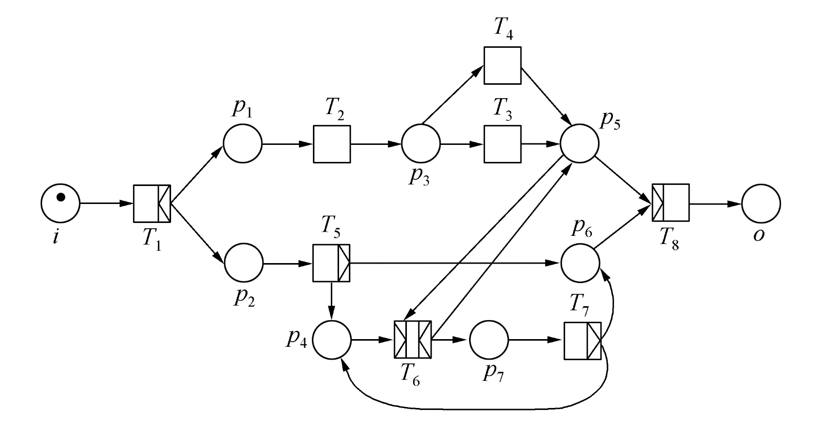
5.3.4 Business Process Modeling and Its Tools (Languages)
⤷ WF-net Transition e.g.)
Meaning of Transition Set T：
T₁: Register
T₂: Send out survey
T₃: Process survey
T₄: Handle expiration
T₅: Evaluate complaints
T₆: Handle complaints
T₇: Check processing results
T₈: Archive
Place Set P：
i： Start ；
o：End
p₁, p₂,p₃, …, p₇ : Intermediate places
Notes:
与分支（AND-split）：有1个输入满足条件（有令牌），变迁发生并输出n个同时进行的分支（都有令牌）继续流程。
或分支（OR-split）：有1个输入满足条件（有令牌），变迁根据流程的逻辑和条件，在输出的n个分支中，激活1个或多个分支路径（有令牌）继续流程。并不是所有的输出都必须同时满足条件（有令牌）。
与连接（AND-join）：当所有n个输入都满足条件（有令牌），变迁发生并输出1个令牌继续流程。
或连接（OR-join）：n个输入中至少有1个满足条件（有令牌），变迁发生并输出1个令牌继续流程。
变迁集T含义：
T₁：登记； T₂寄出调查表；
T₃：调查表处理； T₄：过期处理；
T₅：投诉评估； T₆处理投诉；
T₇检查处理结果； T₈：归档保存.
库所集P：
i：起始；
o：终止
p₁, p₂,p₃, …, p₇ :中间库所
投诉处理工作的流程

Slide 68
Chapter 5：Function • Brief summary
Objective :
Key Concepts ：

